Slide 1

CEDS: What it is, Why do it, and What you can expect
Jessica Atwood, Senior Economic Development Planner

Slide 2
Comprehensive Economic Development Strategy (CEDS)
It’s more than a plan, it’s a process!
A framework for regional economic development planning
Program of the U.S. Economic Development Administration (EDA)
Required to be eligible for certain EDA funding programs

Slide 3
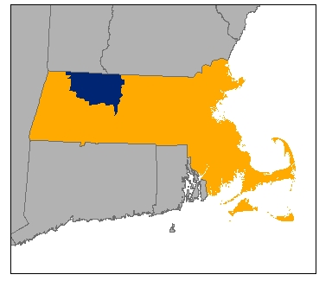
Background
Franklin County, Massachusetts
25 towns and City of Greenfield
Total population of 71,000
Role of Franklin Regional Council of Governments
Regional Planning Agency & municipal services organization
Need for regional economic development planning
Stagnant population trend
Need for higher wage jobs
Preserve what’s important and nurture what we can grow
Notes:
But first a little background….
I’m with the Franklin Regional Council of Governments.
Regional Planning Agency & municipal services organization for Franklin County
Economic Development Planning Program - CEDS Program, Brownfields Program, Broadband Planning
Most rural region of Massachusetts
25 Towns and 1 City (Greenfield)
71,300 population in 724 sq. miles – about ¾ of our towns have fewer than 2,000 people
Similar demographic and economic profile –
Rural landscape, manufacturing, value agricultural land and natural resources, need for improved broadband access, etc.
Need for regional economic development planning
Stagnant population trend
Need for higher wage jobs
Importance of manufacturing industry
Identify growth opportunities
Role of regional organizations

Slide 4
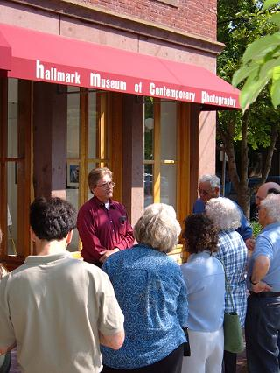
Greater Franklin County CEDS
Greater Franklin County CEDS Region:
26 municipalities of Franklin County
Plus Amherst, Athol and Phillipston
From 1995 Overall Economic Development Plan to 2012 CEDS Annual Report
In 2006, designated an Economic Development District (EDD)
Tour of Colle Opera House Redevelopment,
Montague, MA
Notes:
CEDS Region – 26 towns plus Amherst, Athol & Phillipston
Self-defined region
Amherst is home to the largest employer of FC residents
Athol is closely tied to Orange economy
Began with 1995 Overall Economic Development Plan
Completed 4 five-year plans, and intervening annual reports
Most recent document, the 2012 CEDS Annual Report
Designated an Economic Development District in 2006
Has just received its 7th EDA planning partnership grant.
Before EDD designation, completed CEDS process using own resources.

Slide 5
The CEDS Process
Requires Steering Committee
Public and private sector representation
CEDS Region
Locally defined region; Region not determined by EDA
Creation of a CEDS Plan
Five-year Plan with annual updates
Review of region’s economic situation
Identification of goals, clusters and important projects
Notes:
Creation of Steering Committee
If an EDD, requires an EDD Governing Board – depends on organization’s current structure
Self-defined region. Not dictated by EDA.
For example, Pioneer Valley Planning Commission includes Franklin County as part of its region.
Must produce a five-year Plan that
Reviews economic situation
States a vision and goals
Identifies important clusters – economic groupings of businesses and institutions with some similarity in industry, operation, or technology, and which are generally located within a defined geographic area
Includes listing of important projects

Slide 6

Why do a CEDS?
Access to EDA funding programs
Planning and strategy projects
Construction/infrastructure projects
Small business revolving loan funds
Economic Development District planning partnership
Special funding opportunities for disaster impacted areas and international trade impacted areas
Notes:
Did I mention - access to EDA funding programs?
Planning and strategy grants – need to know more about an emerging cluster, need to do analysis of the region’s industrial market?
Construction & infrastructure grants – the bread & butter of EDA: sewer, water, roads. Must meet certain criteria. Cannot benefit a single private business. Owned by a governmental unit or non-profit. Must result in direct job creation.
Access to capital for small businesses through an RLF.
EDD Planning Partnership – must apply but not competitive. Funds planning work for CEDS process and implementation.
Special Funding opportunities – typically all EDA grants require a 50-50 match (except in areas of particular economic distress) or in cases of FFOs like this (80-20),

Slide 7





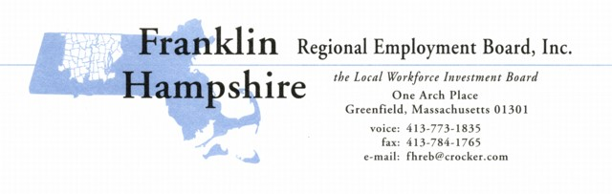




Why do a CEDS?
Convenes public and private sector to talk about economic development issues
CEDS Committee membership guided by EDA rules
Greater Franklin County CEDS Committee
Greenfield Community College
Notes:
Convenes public and private sector together
Specifically to talk about economic development
Opportunity to break down silos and build partnerships

Slide 8
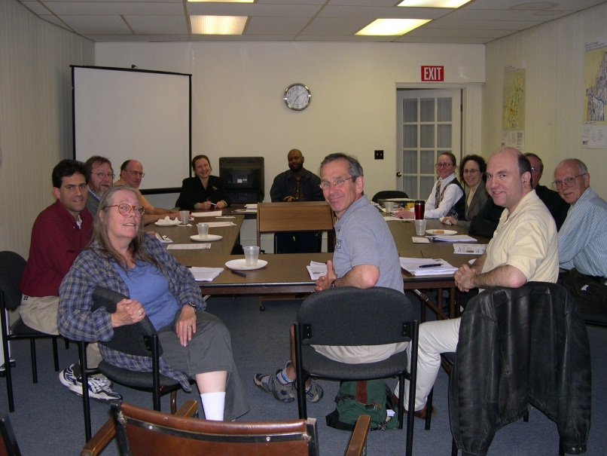
Why do a CEDS?
Opportunity for local capacity building and information sharing
Limited staff available at town level to work on economic development
CEDS document includes useful data and program information
Special presentations at Committee meetings
Notes:
Local capacity building and information sharing
Very few communities have professional planning staff. In FC, only two of 26 towns have professional planning staff.
Municipal staff already burdened by workload and putting out fires. Difficult to keep on economic development programs and opportunities.
Regional organizations, towns and private business can share information.
Bring in speakers to talk about programs and projects – examples, state programs, how tax credit programs work, proposed projects, Hurricane Irene discussion.

Slide 9
Why do a CEDS?
Framework to identify both individual community priorities and region-wide priorities
CEDS Project Listing
Solicit projects from municipalities and organizations
Categorize and evaluate projects
Listing referenced by more than just EDA
CEDS Program scope of work
Reflects region’s common goals and issues
Provide support to important projects and initiatives
Notes:
Opportunity to identify important projects to towns and the region
FRCOG does a project solicitation every five years
Establishes evaluation criteria in advance to rank projects
Different categories of projects – EDA eligible and non-EDA eligible; Construction or Planning
Use list when talking to other funders, the state, legislators
Scope of work
Reflects common goals and issues – ex. Brownfields redevelopment and broadband access
Support to projects region-wide in scope and specific to a community – ex. Downtown revitalization, state grant applications

Slide 10
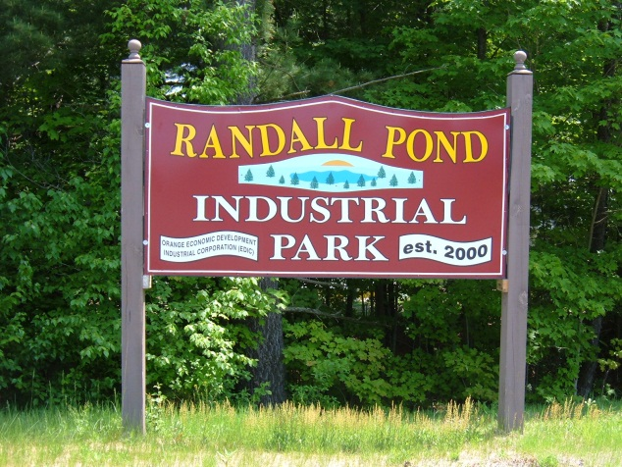


Franklin County Examples
Industrial Park Planning
Support retention and growth of manufacturing sector
Six planned industrial parks in Franklin County
Limited supply of readily developable parcels
Randall Pond Industrial Park, Orange, MA
Awarded a$1 million EDA grant for infrastructure.
Opened in 2001.
RC Precision Sheet Metal, Inc.
Notes:
Industrial Park Planning
Preserve natural areas by targeting development in certain areas.
Manufacturing industries important to region.
Not attracting large scale manufacturers from outside the region, but giving local businesses a place to grow.
Randall Pond Industrial Park – previous CEDS project; Dean’s Beans example – grew out of barn in neighboring small town
Supply of readily developable parcels limited in central part of county.
In coming year, plan to apply for another infrastructure grant to support creation of a park in Montague.

Slide 11
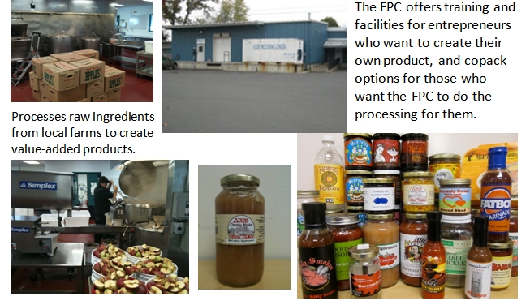
Franklin County Examples
Specialty Food Product Cluster
FCCDC’s Western Mass. Food Processing Center (FPC) in Greenfield
Supports farms and agricultural businesses
Food Systems curriculum and workforce development programs
Extend the Season Program
Notes:
Specialty Food Product Cluster
Unique asset in Western Mass Food Processing Center in Greenfield – food business incubator with a commercial kitchen and access to technical assistance
Similar facility in Hardwick VT and upstate New York
FPC identified as a regional significant project in an early CEDS – but not selected for funding by EDA. Ranking important in USDA application
EDA funding priorities have evolved since then.
Pursuing an EDA grant application to expand cold storage capacity to support expansion of programs for FPC businesses (as well as other operations in the cluster)

Slide 12
What you can expect
EDA sets the framework and focus
Mission to promote innovation and regional competiveness
Encourages a cluster development strategy
Seeks projects that create jobs and leverage private investment
Emphasis on areas of economic distress
However, the region has flexibility in its implementation and use of CEDS
Notes:
EDA sets the framework and focus
Mission to promote innovation and regional competiveness
Encourages a cluster development strategy
Seeks projects that create jobs and leverage private investment
Emphasis on areas of economic distress
However, region has flexibility in its implementation and use of their CEDS
Determine region boundaries
Identify its own clusters and goals
Prioritizing projects

Slide 13
What you can expect
EDA funding is very competitive.
Competing against other projects in Region 1 or nation
Requires non-federal funding match
Must meet EDA’s investment policy guidelines
Participation is more than just about the grants
Excellent vehicle for collaboration
Opportunity to fund economic development activities
Notes:
EDA funding is very competitive.
Competing against other projects in Region 1 or nation
Requires non-federal funding match
Must meet EDA’s investment policy guidelines
Participation should not just be about grants
Excellent vehicle for collaboration
Opportunity to fund economic development activities

Slide 14
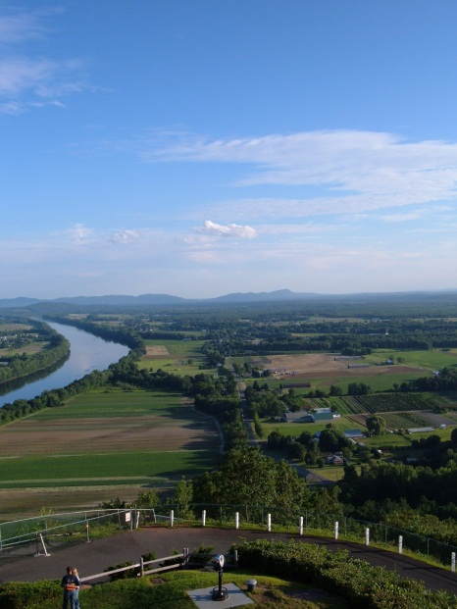

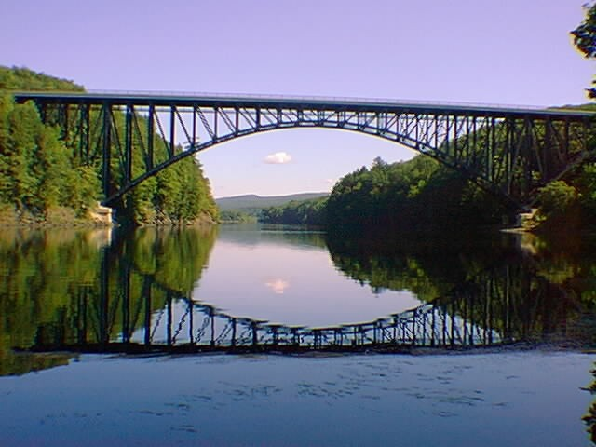
Questions?
Jessica Atwood
Senior Economic Development Planner
Franklin Regional Council of Governments
jatwood@frcog.org
413-774-3167 x123

